Slide 1
Employee Record System
Presented By :
Naim , Abir

Slide 2
Prepared by :
Md Elias Hassan Naim ID: 15162103056
Abir Mahmud Shovon ID: 15162103054

Slide 3
Contents
Introduction of the project
Project Summary
Advantage of Employee Record System
System Design
Implementation

Slide 4
Introduction of the project
The employee record system is very simple and for very beginner mini project. It is based on the menu-driven program for elementary database management. It employ all the basic technique of file handling in C. It consists of following features
Writing the data in binary file
Reading the data from binary file
Modify the record
Delete the record
This project is a learning milestone for beginners who want to step into the database management project in C.
Employee database record system is consistent of crucial work-related and important personal information about an employee. In a nutshell, it is an online inventory of all employees of an organization.
Listed below are a few reasons why employee database management system is important for startups and small businesses

Slide 5
Project Summary
In this project at first a file will created which will store all record of employees name, age, sallery & income tax.
In at "Add Records" section there has to fill the employee name, age & sallery.
At the "List Records" section we can see all employees record of that Industrie/Instiitution.
In the "Modify Records" section we can change the records of an emploee.
"Delete Records" section used to delete records of an employee.
"Exit" section is used for closed this program.
The featuer of income tax will calculated automatically based on sallery.

Slide 6
Advantage of Employee Record System
As it is intranet application it can be accessed by multiple users at a time.
Proposed system provides domain login facility so no need to remember user id and password.
Very fast and accurate.
No need of extra manual effort.
Just need a little knowledge to operate the system.
Doesn’t require any extra hardware device.

Slide 7
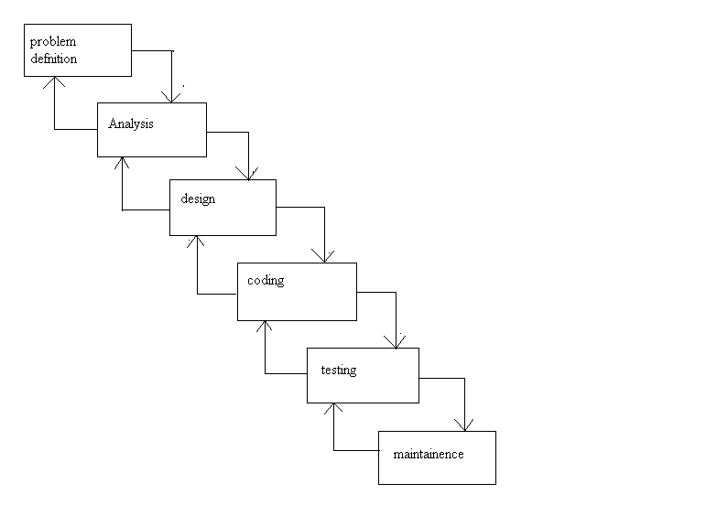
System Design
Analysis

Slide 8
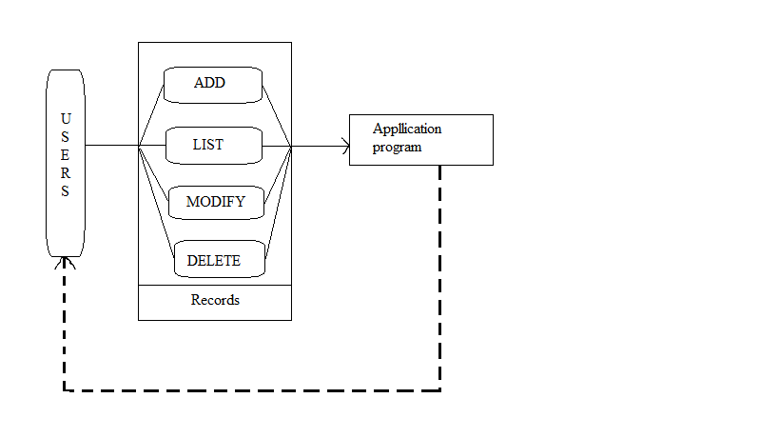
Overall design

Slide 9
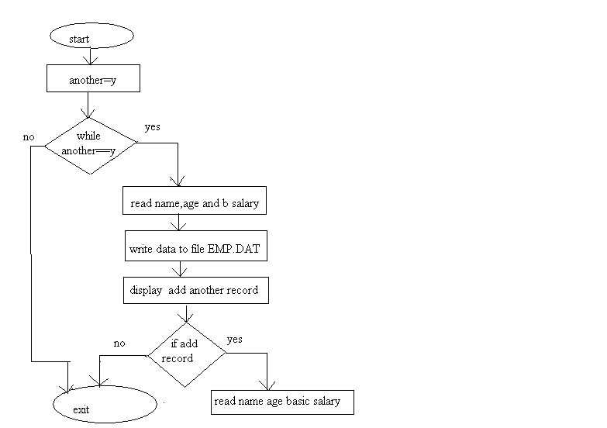
Modules
Add Module

Slide 10
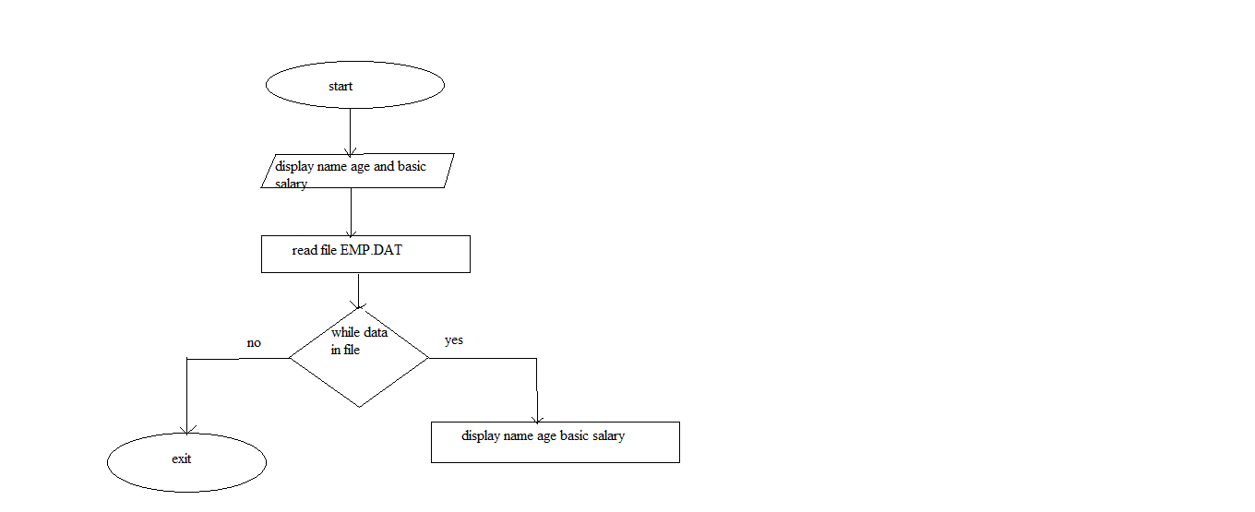
List Module

Slide 11
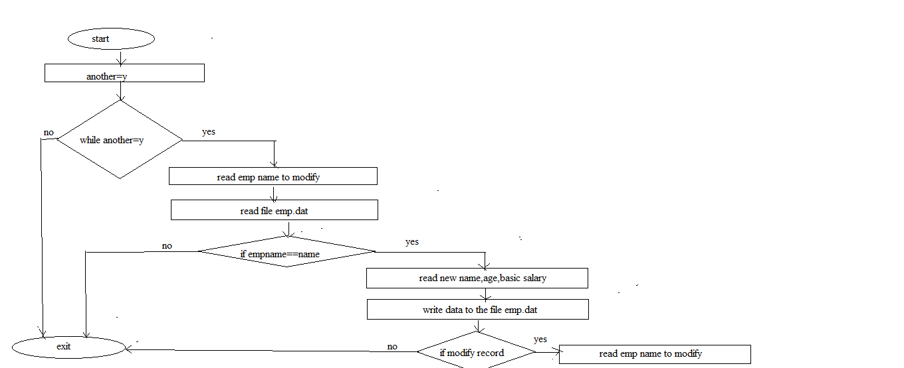
Modify Module

Slide 12
Implementation
Pseudo code for add module:
start module
set variable another to y
while another equal to y then
read name, age and basic salary
write the data to the file
display add another record, read yes or no
if yes then
read name, age and basic salary
else
return
end if
end while
end module

Slide 13
Pseudo code for list module
start module
display employee name, age and basic salary
read file
while data in file then
display name, age and basic salary
end while
end module

Slide 14
Pseudo code for modify module
start module
set variable another to y
while another equal to y
read employee name to modify
read file
ifempname is equal to name entered then
read new name, age and basic salary
write the data to the file

Slide 15
end if
end while
display modify another record
read yes or no
if yes then
read employee name to modify
else
Return
end if
end module

Slide 16
Pseudo code for delete module
start module
set variable another to y
while another equal to y
read employee name to delete
set file pointer ft to the file temp.dat
while data in file then
ifempname is not equal to the name entered then
write the data to the file pointed by file pointer ft
end if
end while
closefilepointerfp

Slide 17
closefilepointerft
remove emp.dat
rename temp.dat to emp.dat
setfilepointerfp to the file emp.dat
display delete another record
read yes or no
if yes then
read employee name to delete
else
return
end if
end while
end module

Slide 18
Thank You ☺

